Slide 1
Deep Learning for Natural Language Processing Lecture 3: CNN and RNN for Sentiment Analysis
Quan Thanh Tho
Faculty of Computer Science and Engineering
Ho Chi Minh City University of Technology

Slide 2
Acknowledgement
Some slides are from Coursera course of Prof. Andrew Ng.

Slide 3
Agenda
CNN for feature (generation) and selection
CNN for NLP
Sentiment Analysis
Deep Architecture: Combination of CNN and RNN for Sentiment Analysis

Slide 4
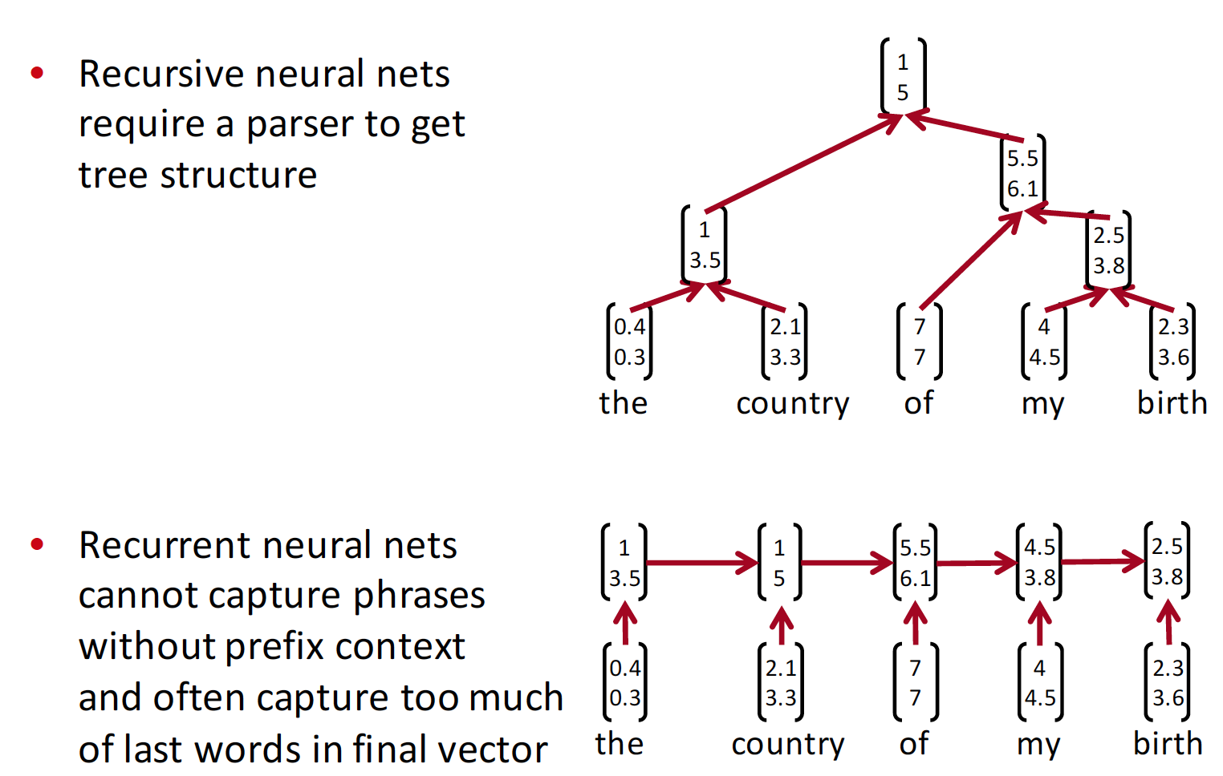
From RNN to CNN

Slide 5
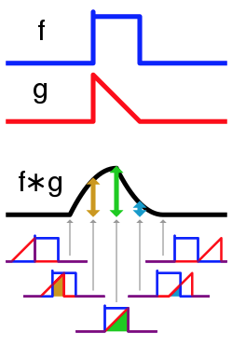
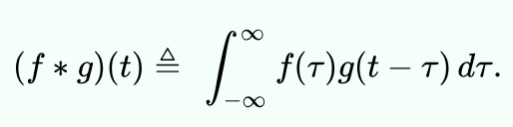
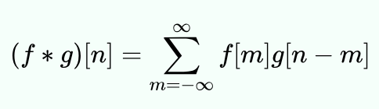
Convolution
In mathematics convolution is a mathematical operation on two functions to produce a third function that expresses how the shape of one is modified by the other. The term convolution refers to both the result function and to the process of computing it.

Slide 6
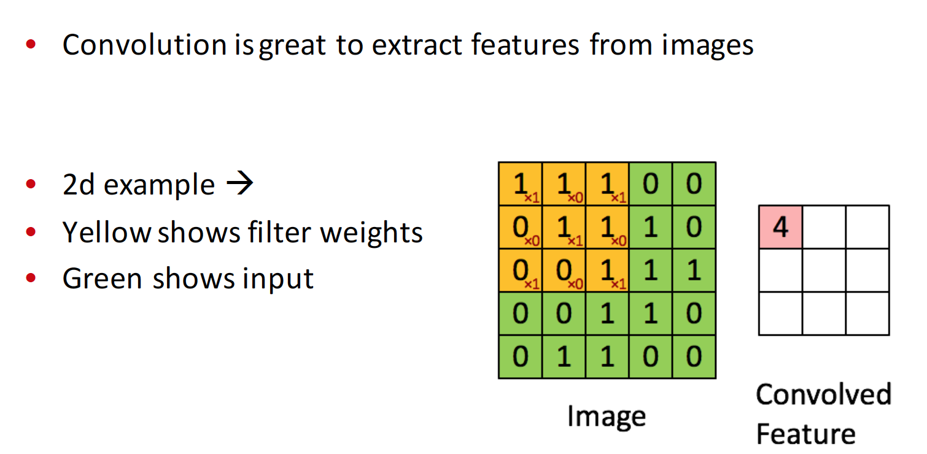
Convolution for feature extraction

Slide 7
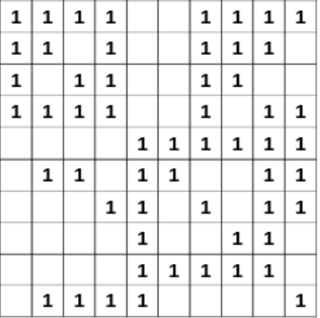

Slide 8
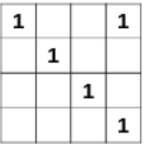

Slide 9
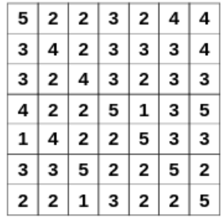

Slide 10
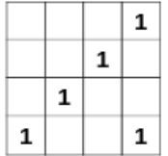
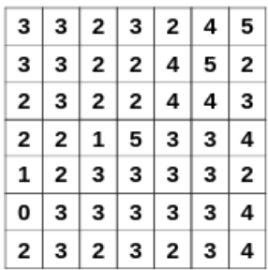
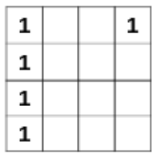
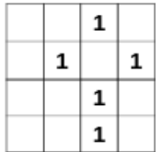

Slide 11
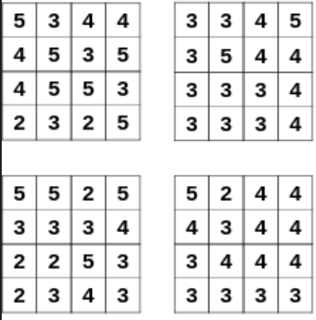
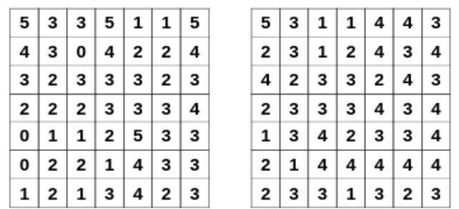
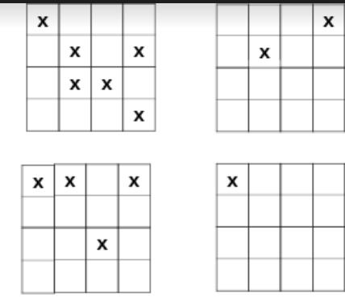

Slide 12
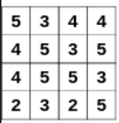
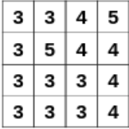
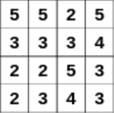
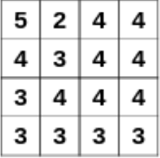
How many convolutional windows (filters)
What are they?
→ let the NN learn for us

Slide 13
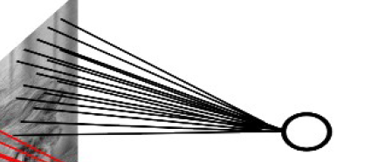

Slide 14
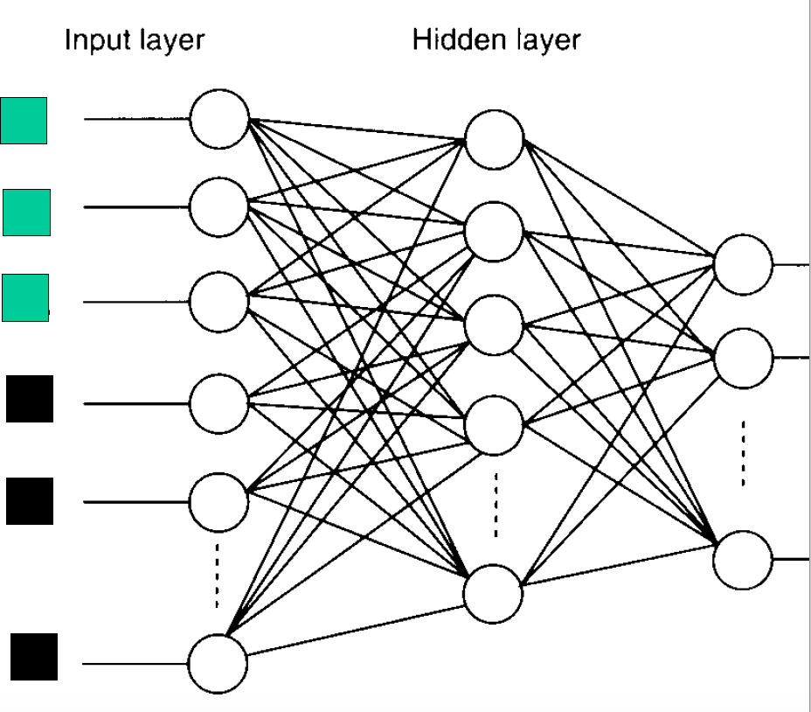

Slide 15
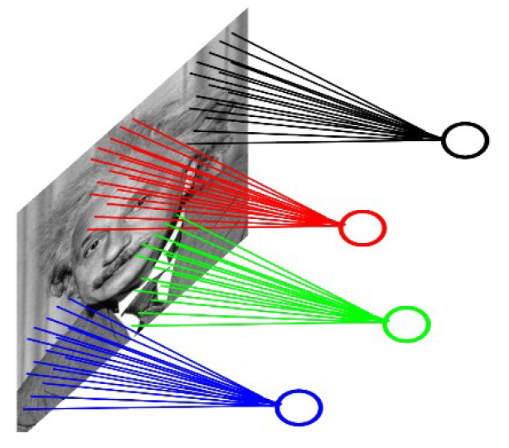
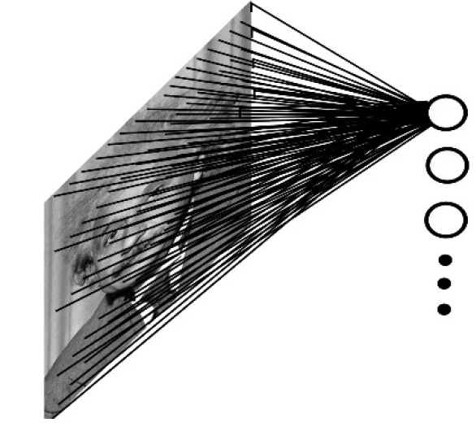

Slide 16
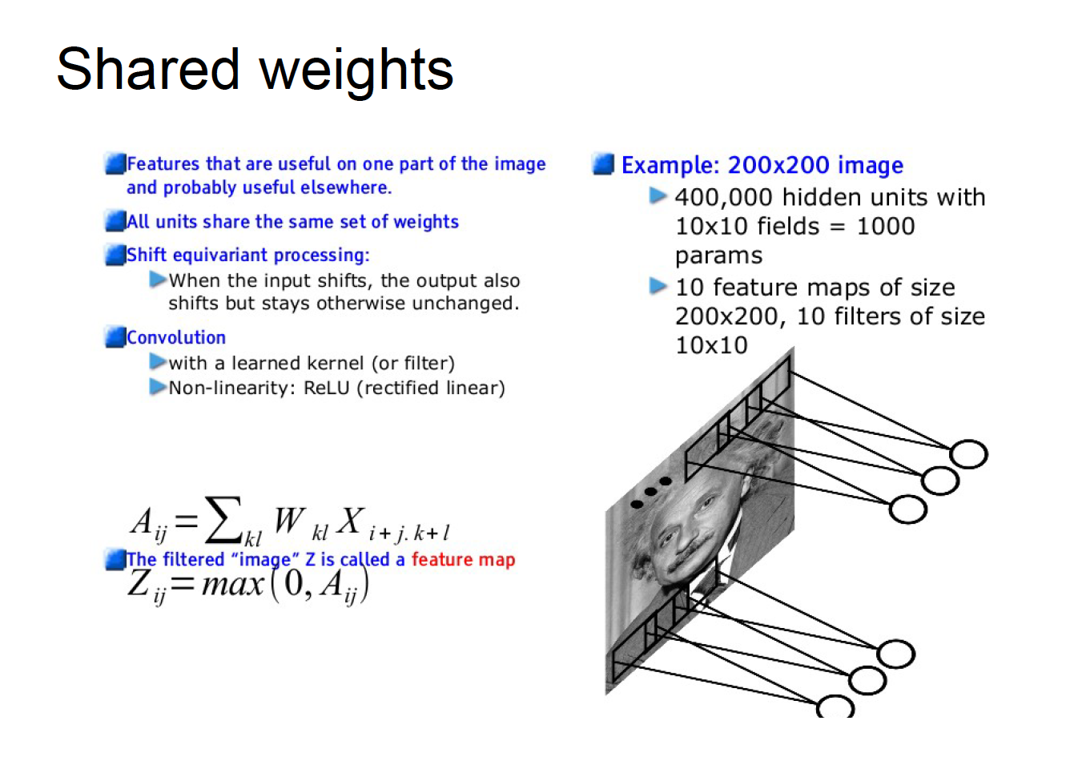

Slide 17
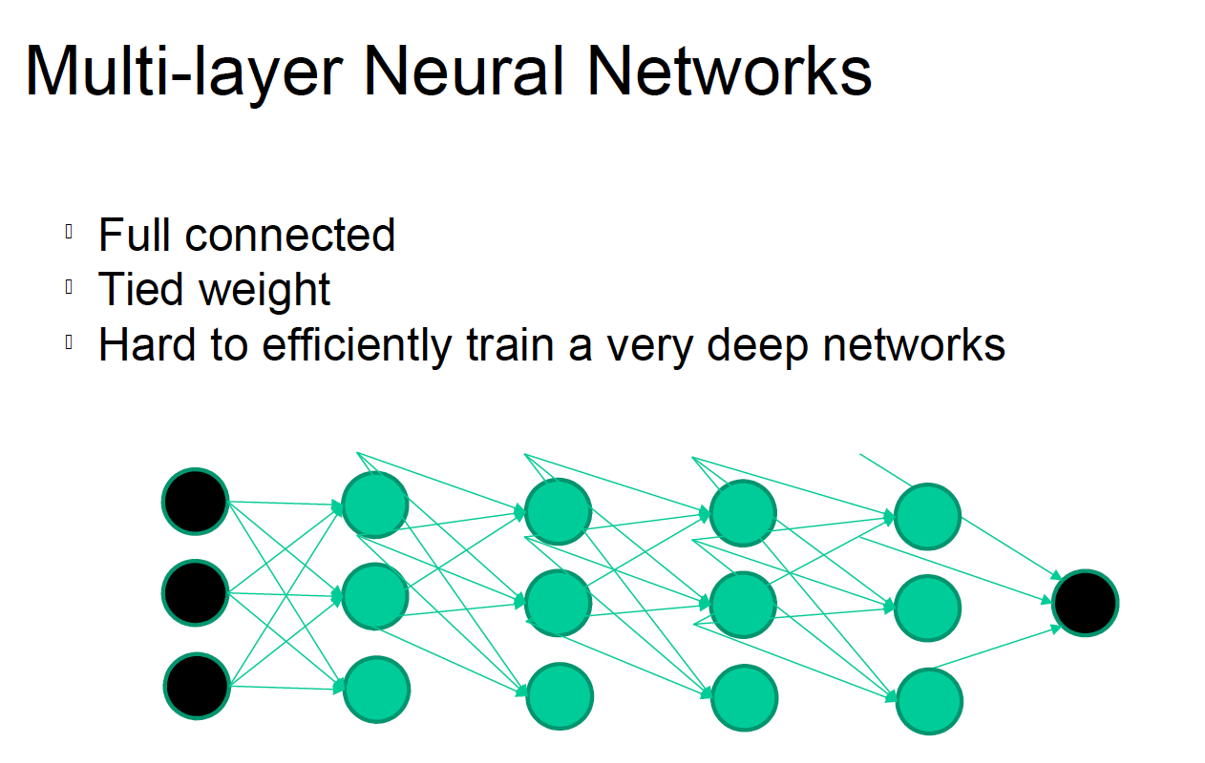

Slide 18
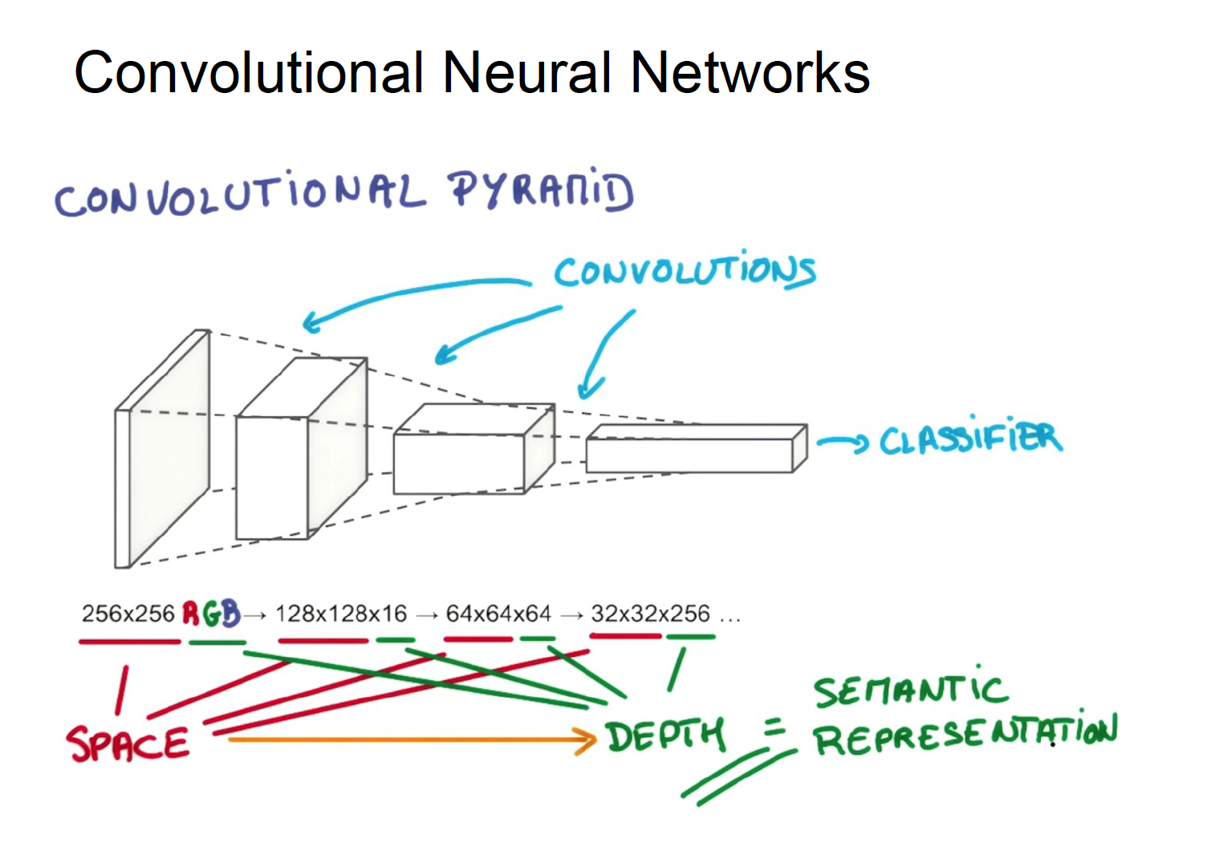

Slide 19
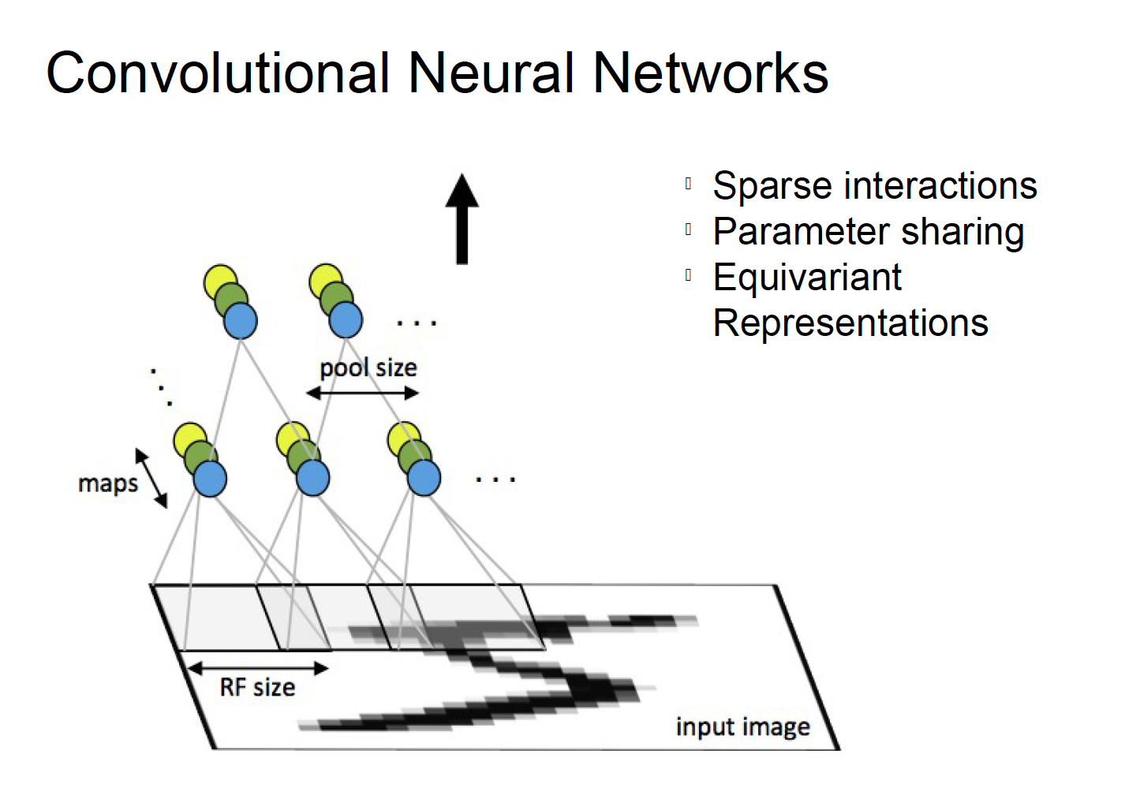

Slide 20
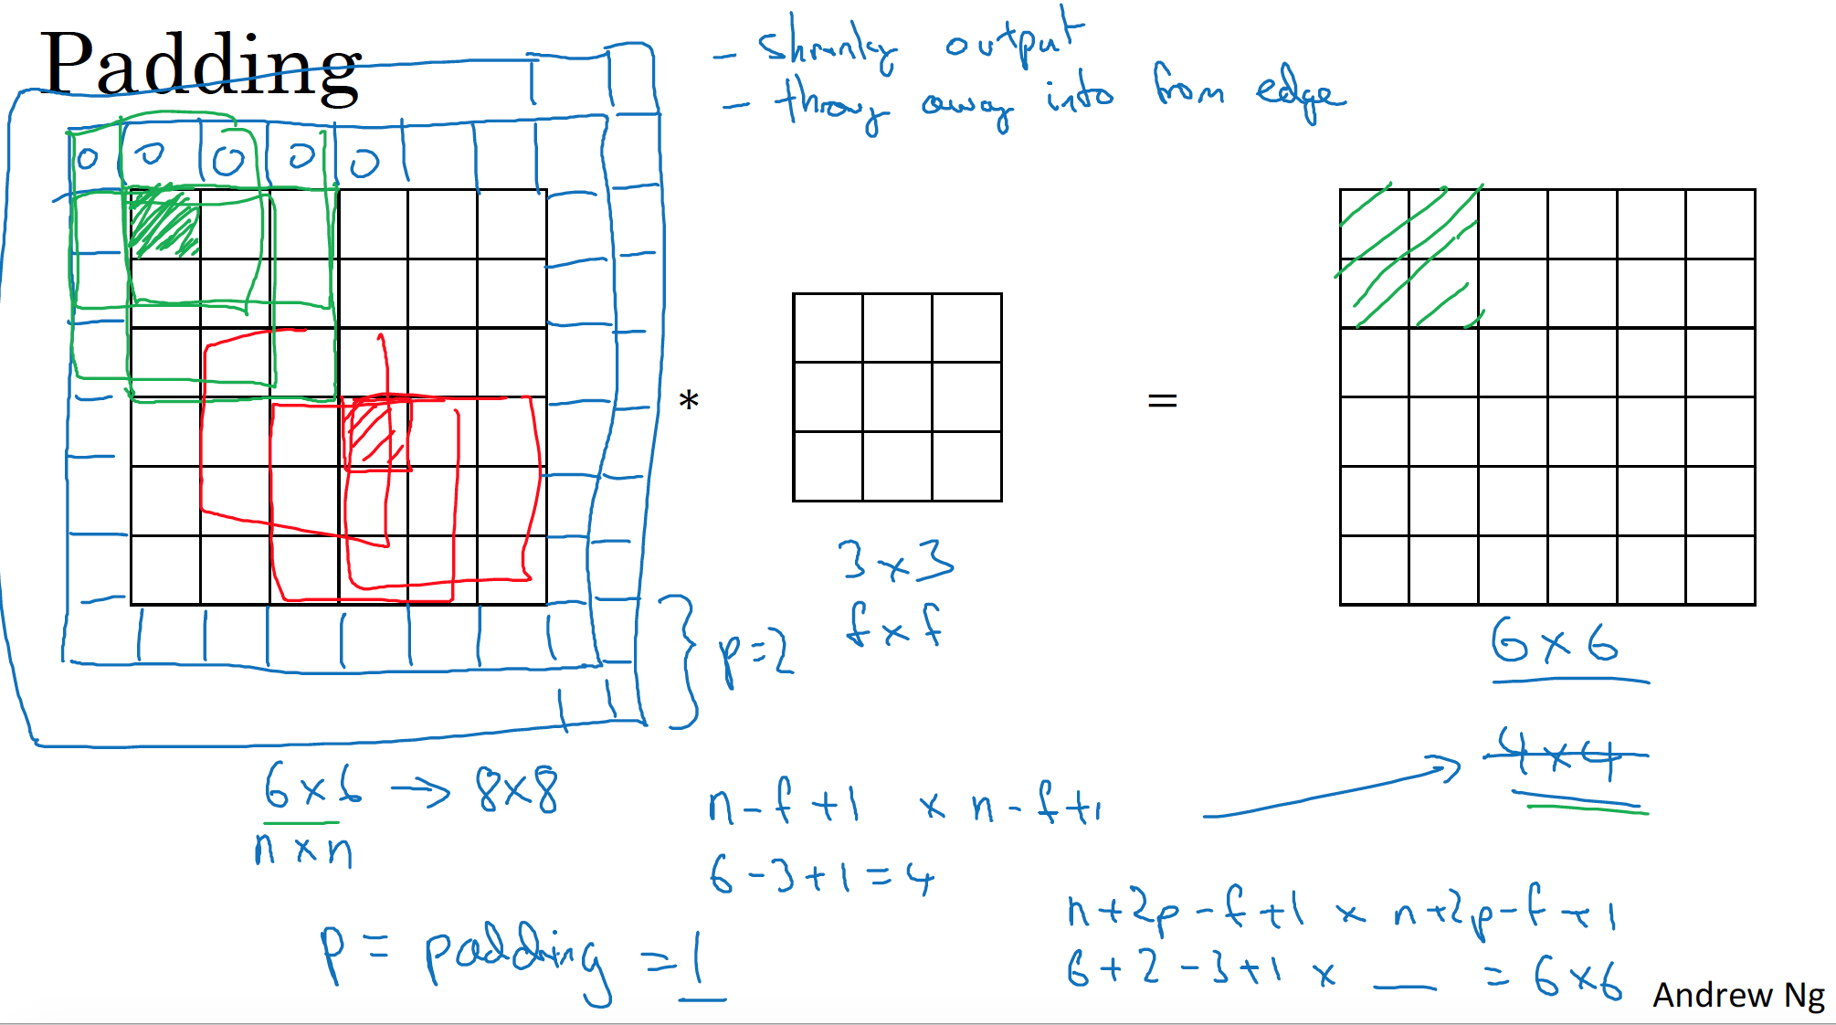

Slide 21
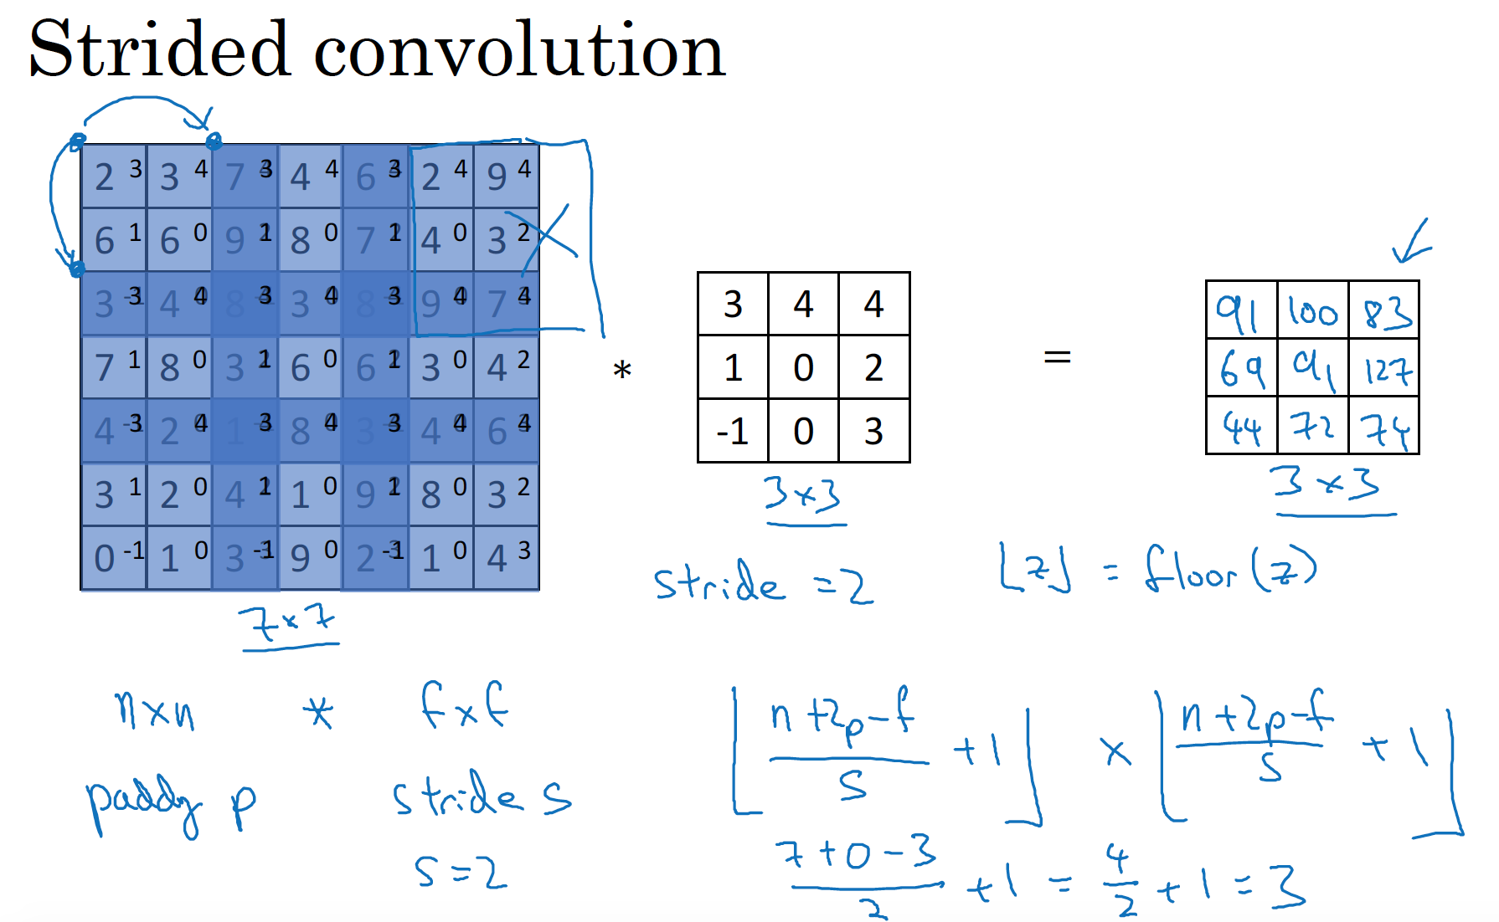

Slide 22
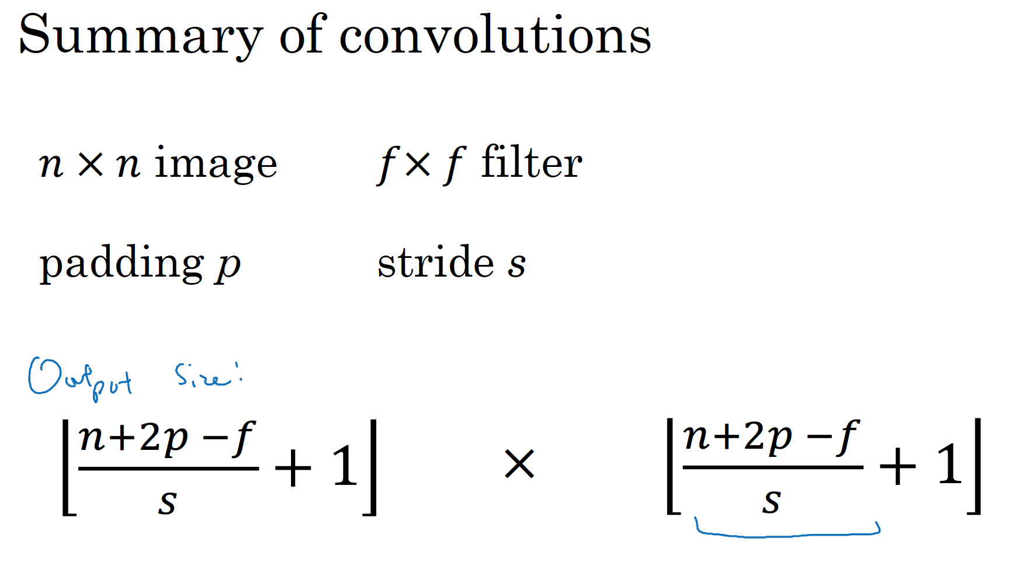

Slide 23
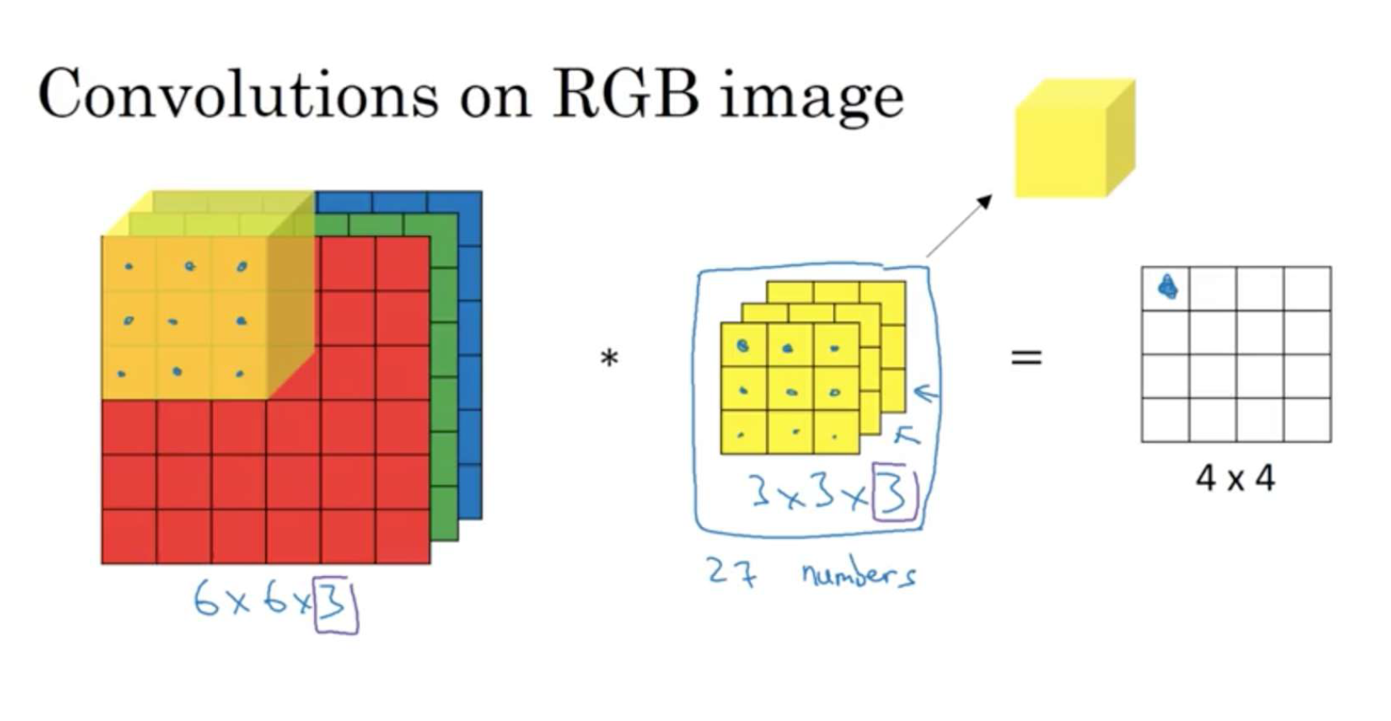

Slide 24
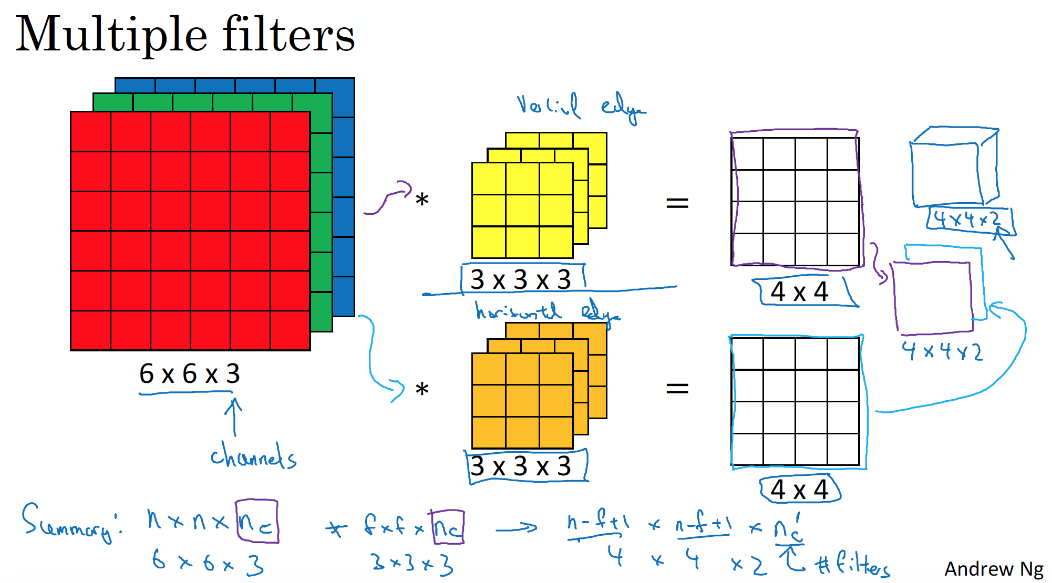

Slide 25
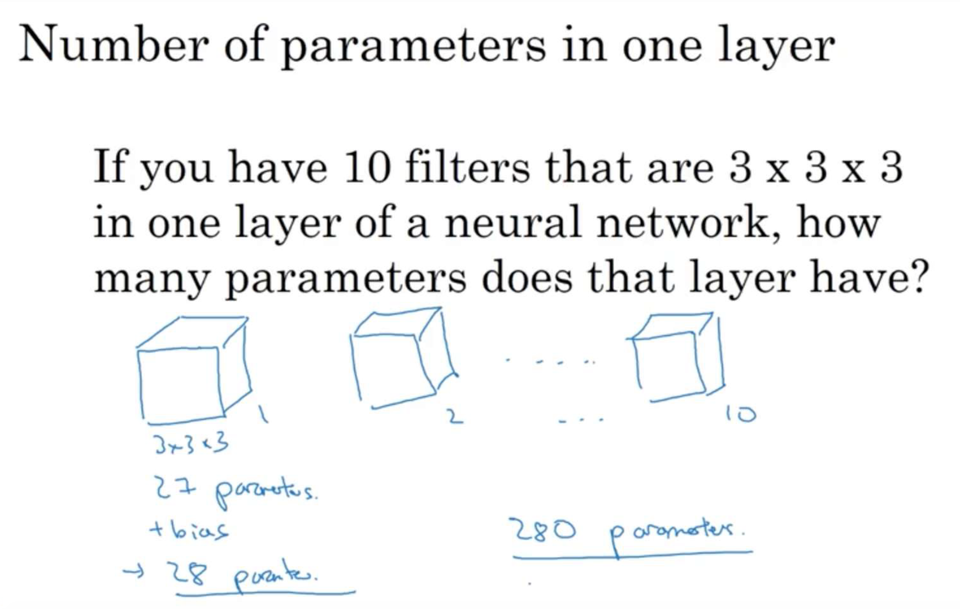

Slide 26
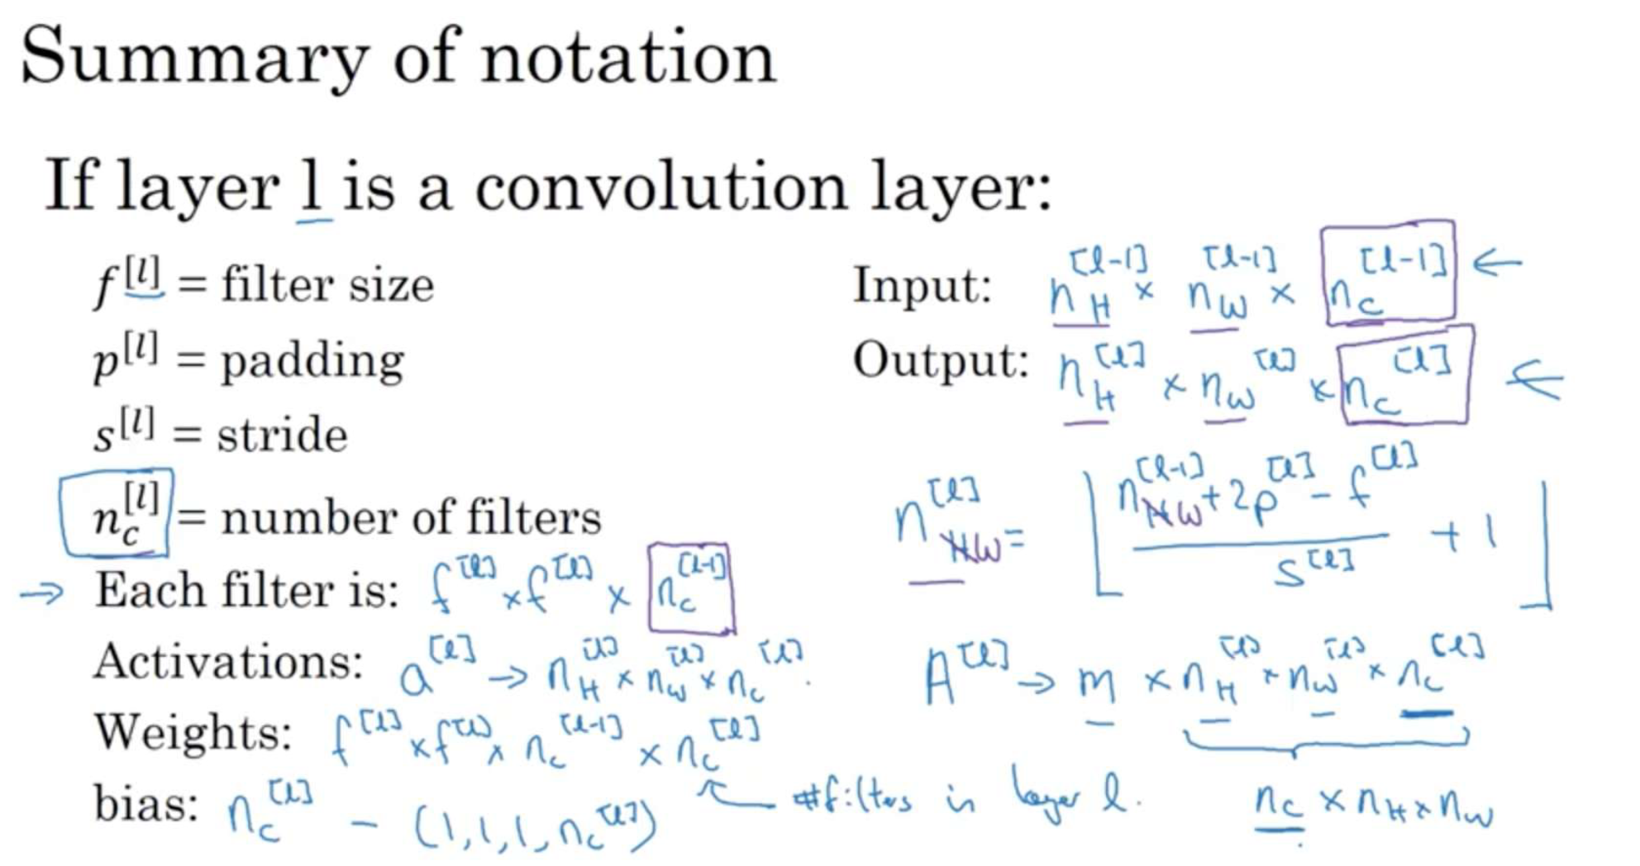

Slide 27
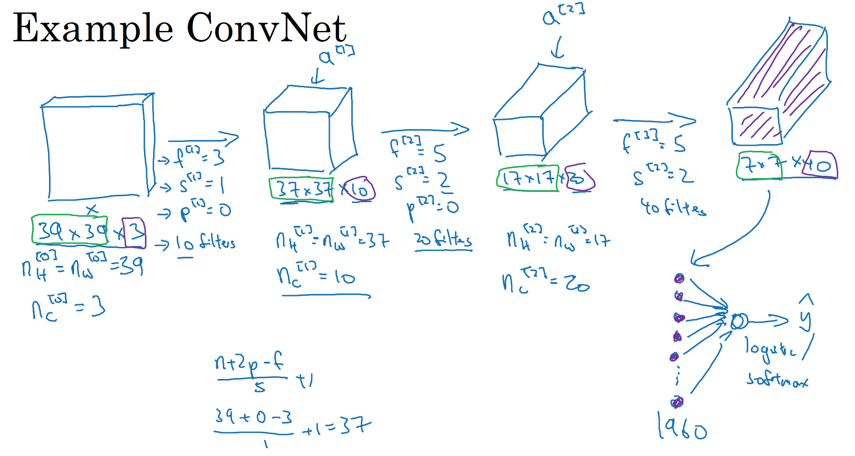

Slide 28
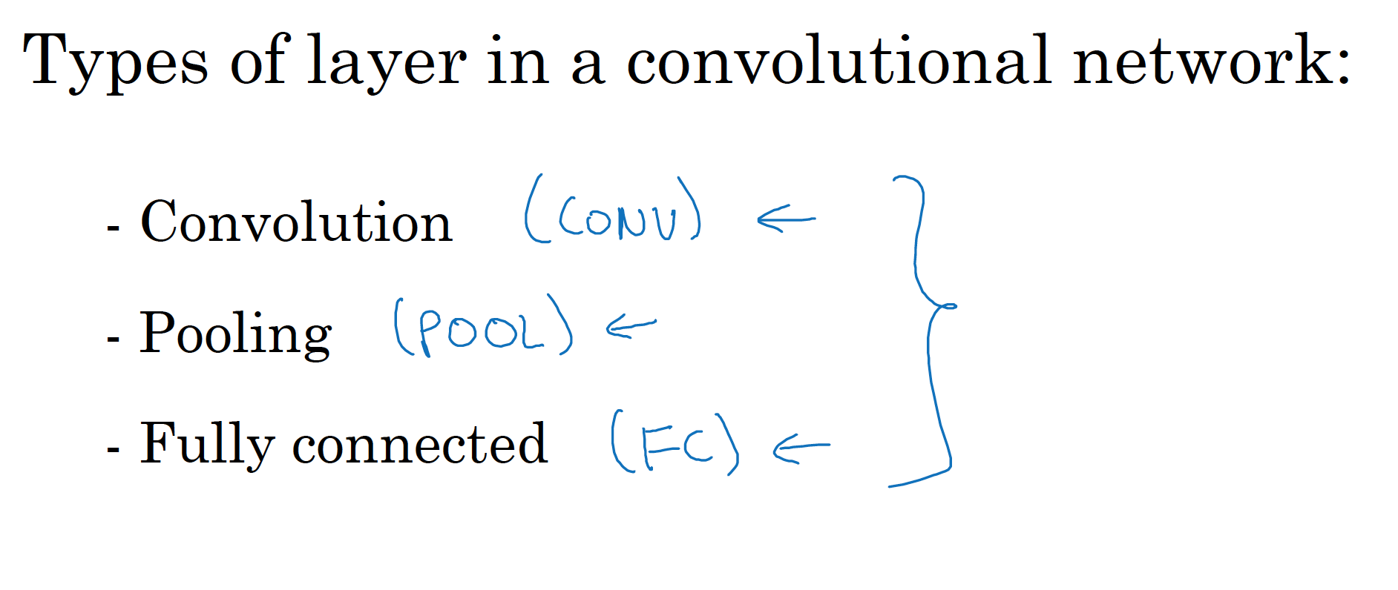

Slide 29
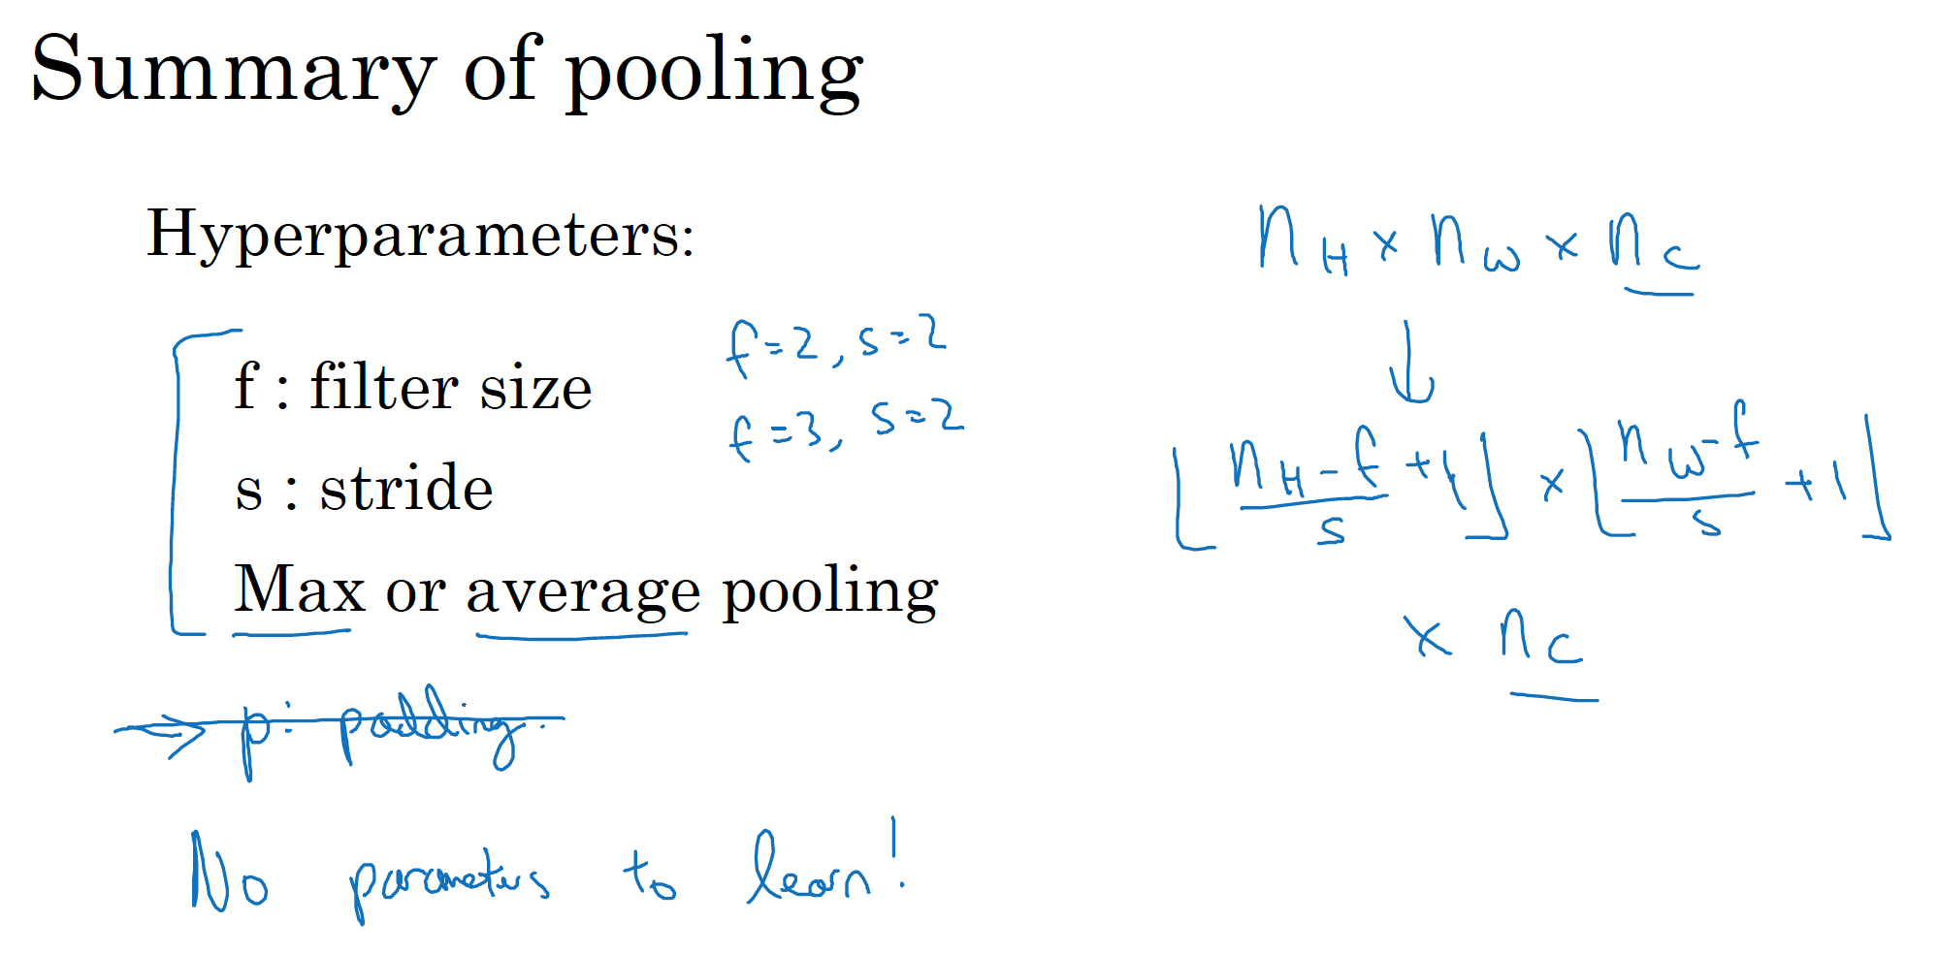

Slide 30
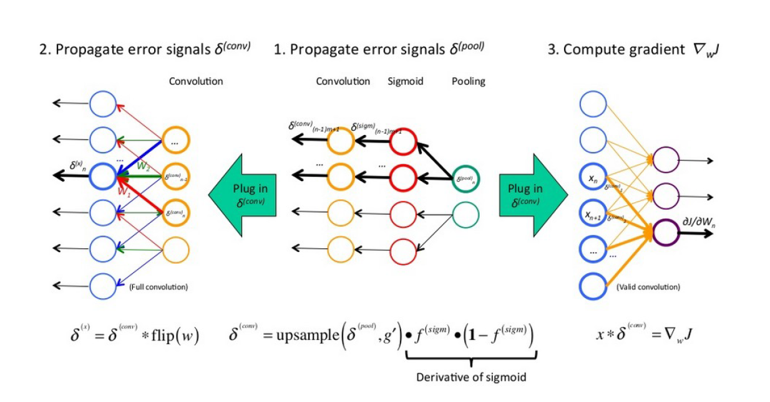

Slide 31
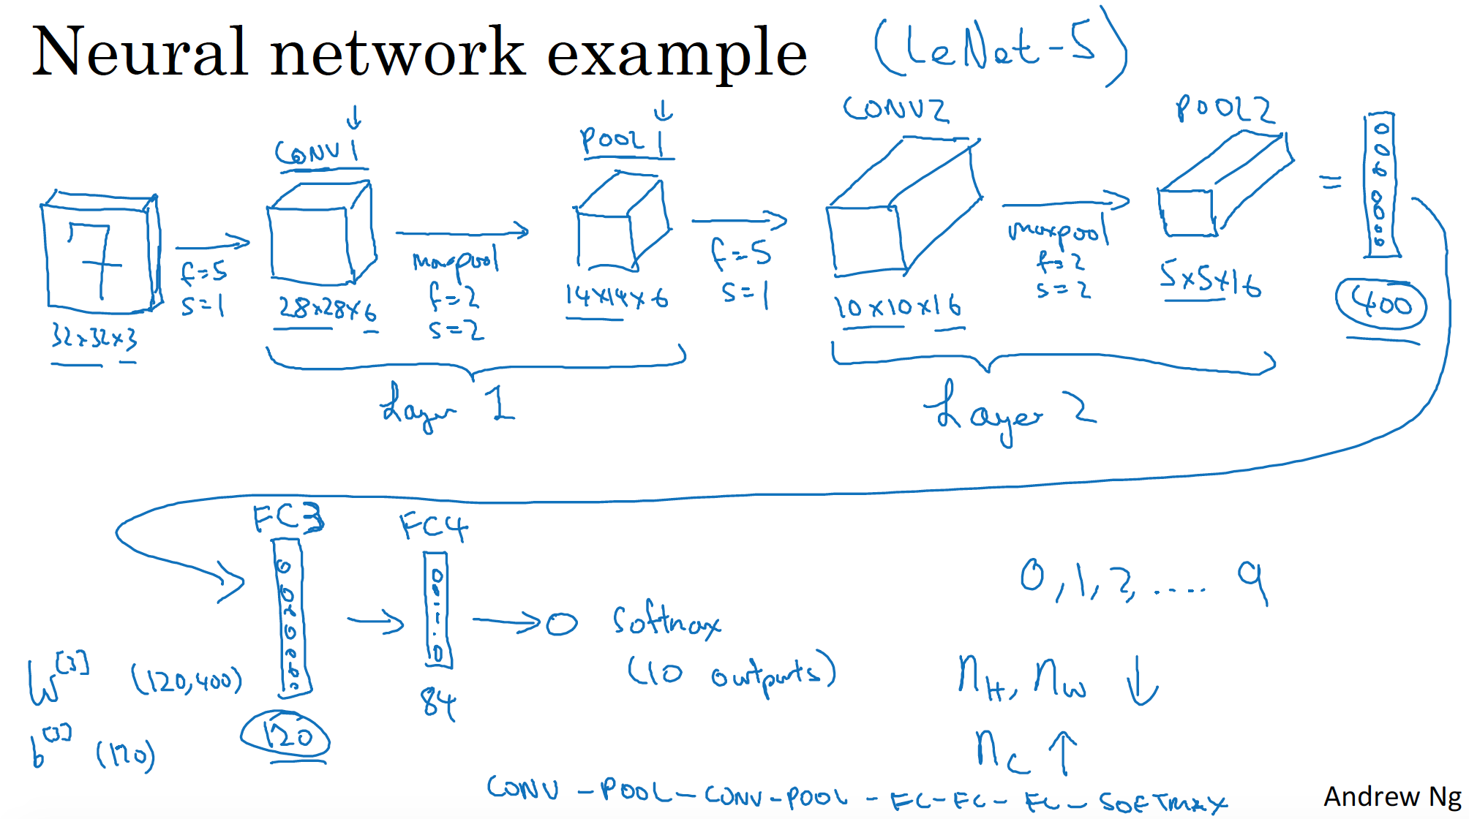

Slide 32
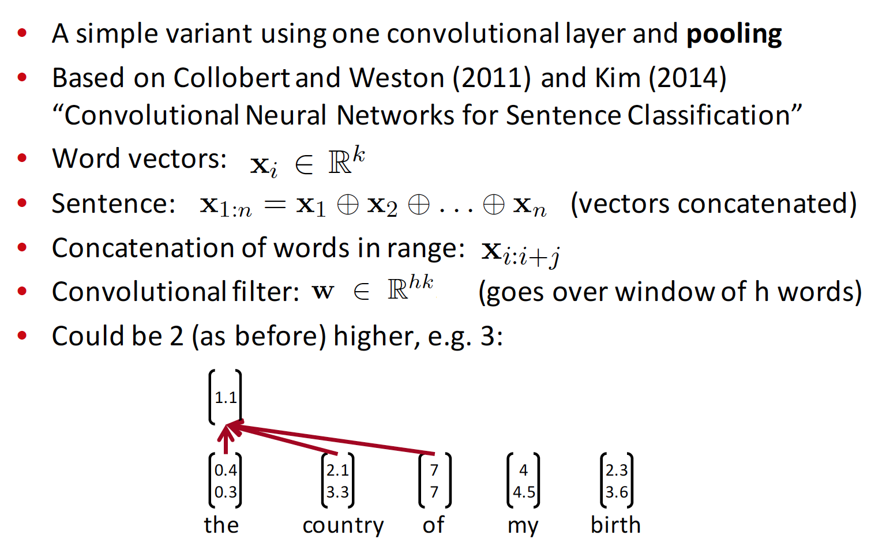
Single layer CNN for NLP

Slide 33
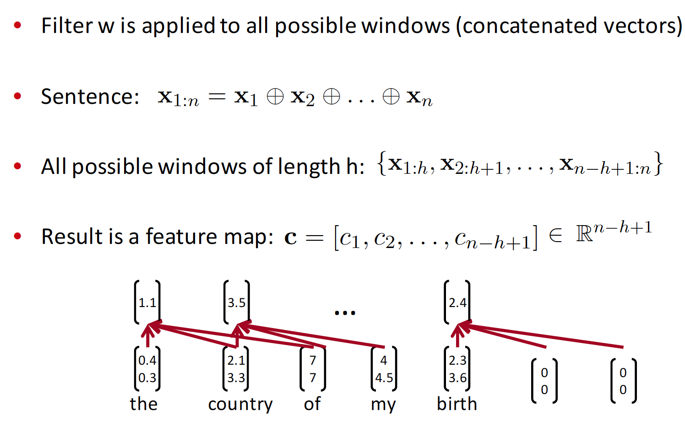
Representation of n-gram relations

Slide 34
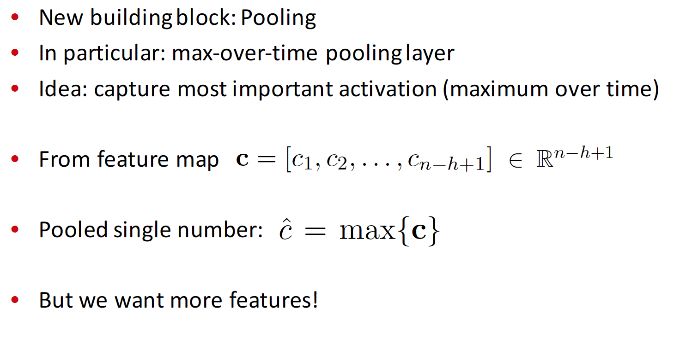
Pooling layers

Slide 35
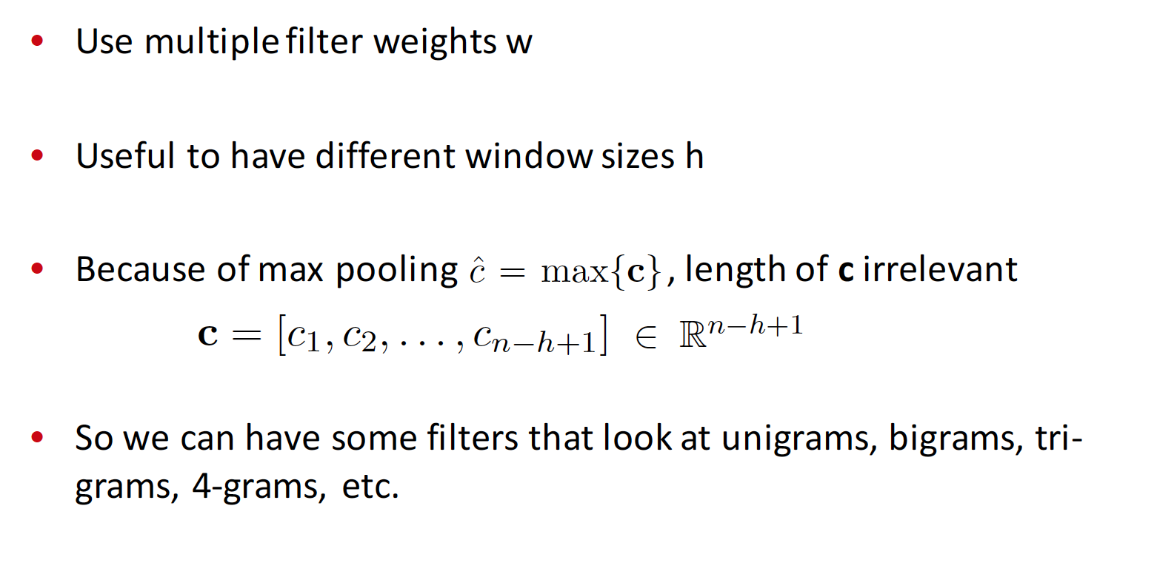
Multiple filters

Slide 36
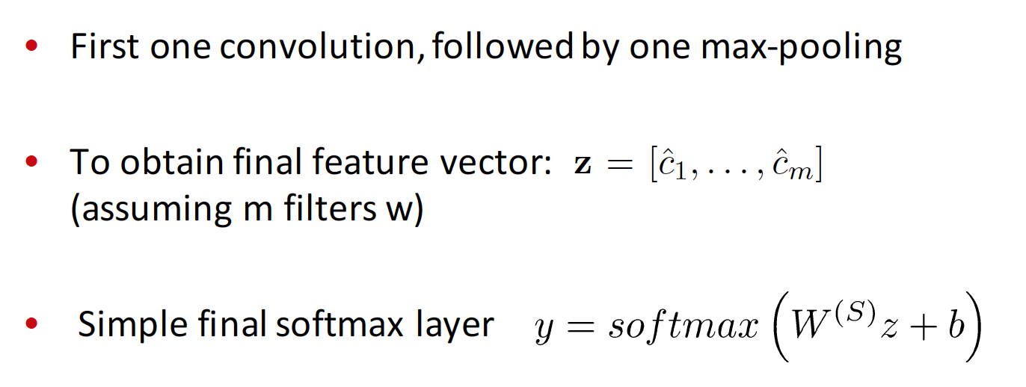
Classification of CNN

Slide 37
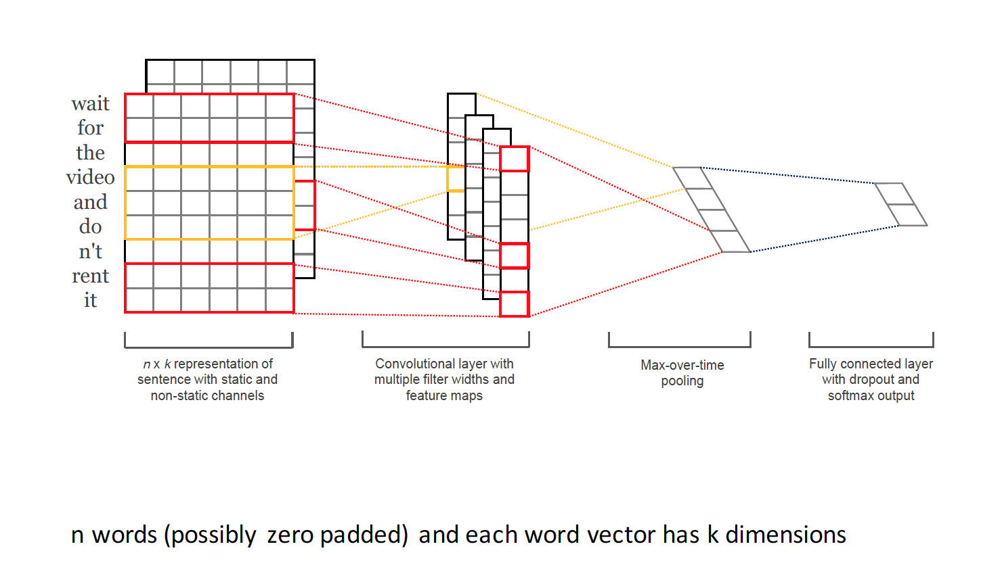
General architecture

Slide 38
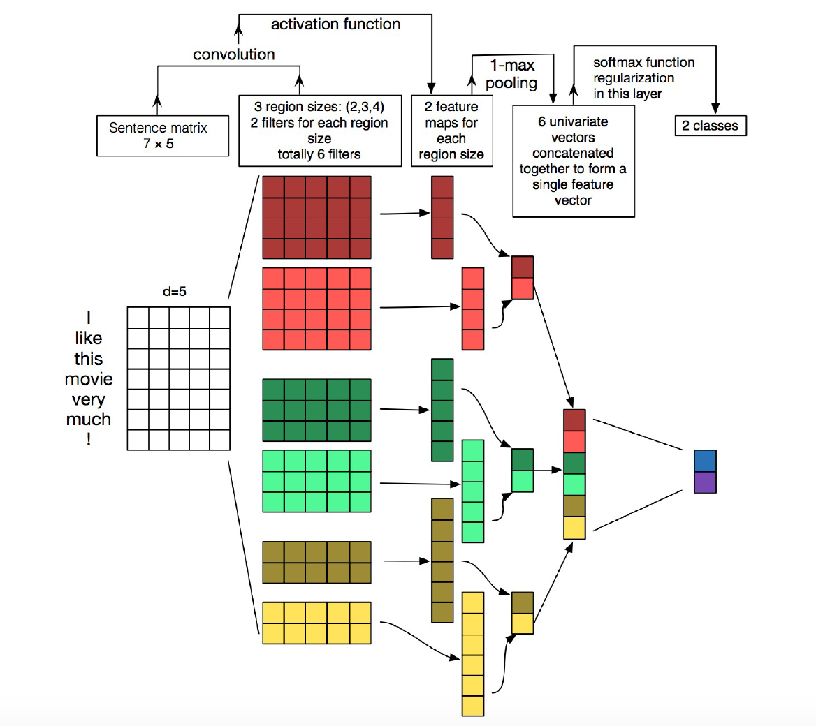
Multiple filters

Slide 39
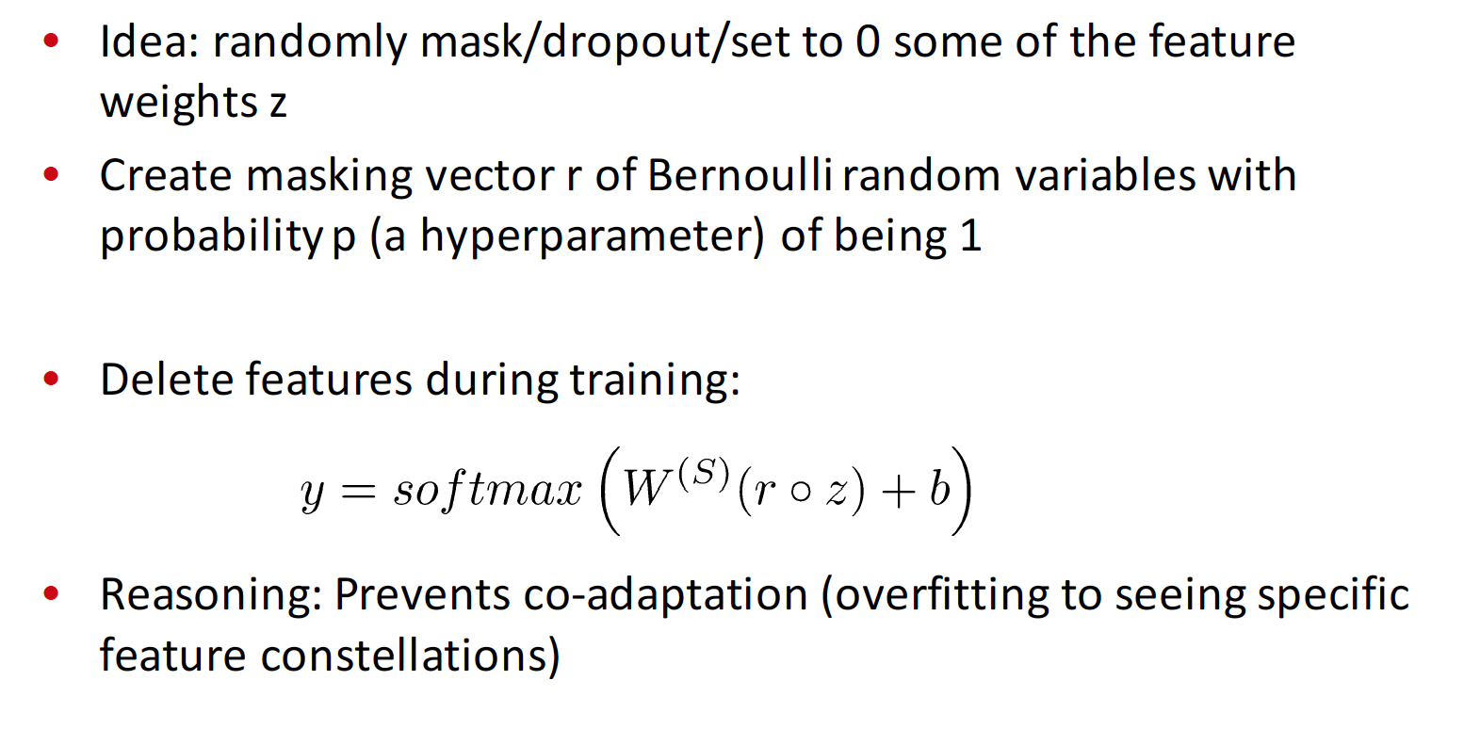
Dropout

Slide 40
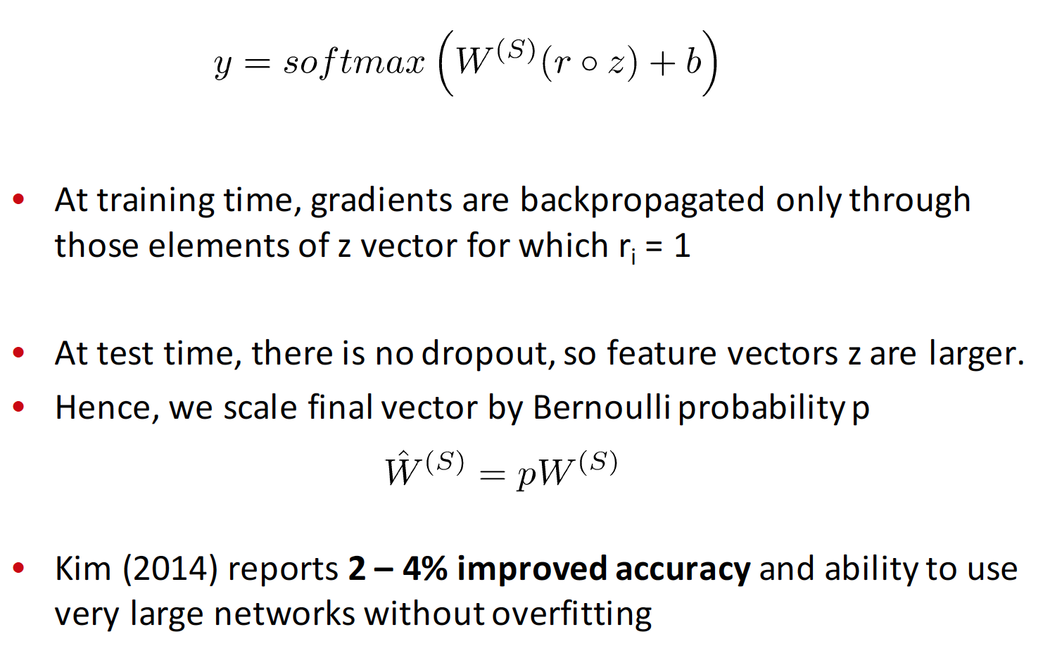
Dropout

Slide 41
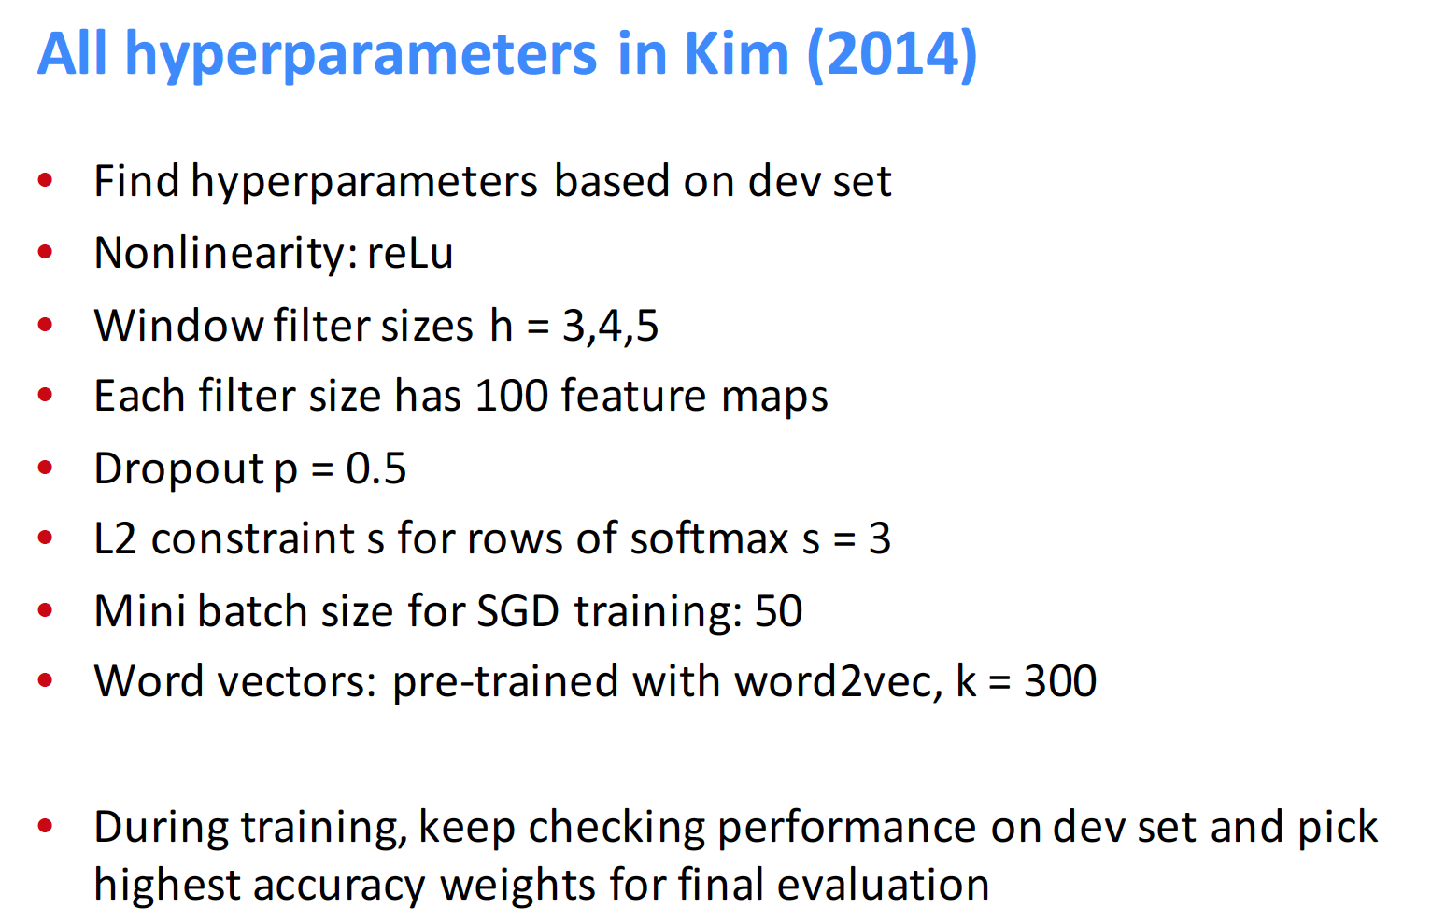

Slide 42

S5 có thiết kết bắt mắt nhưng camera không được nét lắm
Subject: S5 (neutral)
--- Design (+)
--- Camera: (-)
SENTIMENT ENGINE
KNOWLEDGE BASE
Term | Score
bắt mắt | 0.75
nét | 0.75
xấu | - 0.75
tệ hại | - 0.75
Pattern | Action
“không được” A | Lấy phản nghĩa của A
A “không bằng” B | A: positive B: negative
<Domain> Smartphone </>
<Brand> Samsung</>
<Product> S5, Note4 </>
<Attribute>
“thiết kế”,
“camera”</>
Sentiment Dictionary
Pattern Rules
Domain Ontology

Slide 43
Sentiment Analysis
Infer sentiment orientation/opinion in a document (Liu, 2012)
Three levels:
Document level
Sentence level
Aspect level
Notes:
Sentiment analysis (or opinion mining) is a task aiming at inferring opinion of the speaker, which can be either positive, negative or neutral.
There are three levels of sentiment analysis. Document level implies the tone of the whole document, whereas sentence level focuses on the opinion expressed in each sentence separately.
However, in this research, we focus on the aspect level of sentiment analysis, which identifies the object targeted by the opinion, as explained later.

Slide 44
Choosing parameters
https://arxiv.org/pdf/1803.09820.pdf

Slide 45
Aspect-based Sentiment Analysis
S5 has a nice design but its camera does not offer very high resolution
Subject: S5 (neutral)
--- Design (+)
--- Camera: (-)
SENTIMENT ENGINE
Notes:
In this slide, we present an example of aspect level sentiment analysis. Here, we identify the targeted subject is S5.
Moreover, the analysis also present two attributes of the subject, design and camera, which are inferred as positive and negative tones, respectively.

Slide 46
Machine Learning Approaches
Topic Modeling
Extraction of aspect-related opinion works (Qiu et.al, 2013)
Probabilistic Latent Semantic Analysis (PLSA) for aspect and opinion modeling (Mei et. al., 2007)
Latent Dirichlet Allocation (LDA) (Li, 2010; Zhao,2010; Sauper,2011; Mukherjee, 2012)
Notes:
In literature, there are various approaches based on machine learning for sentiment analysis. Most of them are based on topic modeling, with discovers aspects as topics and sentiment words related to each aspect

Slide 47
Deep Learning Approaches
Introduced by LeCun (1989), improved by Hilton (1990)
Standford Treebank and Stanford NLP using RNN (Pang,2005; Manning,2014; Socher, 2013)
CNN approach (Kim,2014)
LSTM approach (Wang,2016)
Automatic recognition of “hidden features”
Performing very well with document and sentence levels
Notes:
With the recent advancement of deep learning, the usage of DL for sentiment analysis has increasingly attract much attentions. Especially, the famous StanfordNLP tool has applied RNN approach for sentiment analysis.
DL is very useful for detection of “hidden features” in document and this approach enjoys very good performance at document and sentence levels.

Slide 48
Notes:
However, if we apply directly LSTM to the original articles, the computation cost is very large, since the number of words in an article may be high. Then, we suggest a combined deep architecture as the presented in the slide. First, word embedding is applied to reduce the dimension number of the word-vector. Then, CNN is applied to select important features of the word-vector. Next, the selected feature will be fed to a LSTM. Finally, a fully connected layer is applied for back-propagation training based on learning error.

Slide 49
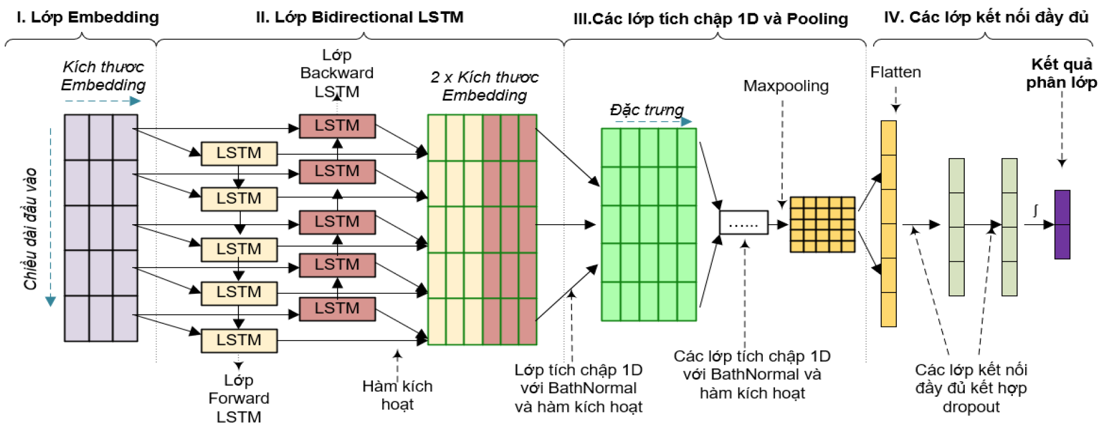
More sophisticated architecture

